Slide 1
Chapter7 System software 7.3 library programs

Slide 2
Syllabus
show an understanding that software under development is often constructed using existing code from program libraries(程序库)
describe the benefits to the developer of software constructed using library files, including Dynamic Link Library (DLL动态链接库) files
draw on(借鉴) experience of the writing of programs which include library routines(库程序)

Slide 3
Library programs库程序
Program library: a collection of pre-compiled routines or modules模块 that a program can use.
Example：numpy

Slide 4
Library programs contain code and data that provide services to other programs such as interface (界面), printing, network code and even the graphic engines of computer games(电脑游戏的图形引擎).
If you have ever wondered why all Microsoft Office programs have the same look and feel, that is because they are using the same graphical user interface libraries(图形用户界面库).

Slide 5
Library programs库程序
The source code is written by the programmer in a programming language such as Python or Java. If no errors are found in the source code, the compiler produces object code (machine code).
This code cannot be executed directly. Instead it has to be linked with the code for any subroutines used by it.
When the subroutines are linked to the source code, the composite code is loaded into main memory to run.

Slide 6
Library programs: DLL (动态链接库)
While the code is running, it links to the DLL routine that it needs. The same DLL (for example, spell-checker code) can be used by a word processor, presentation software and a spreadsheet电子表格 application.
The code in a DLL can be shared among all the processes that use the DLL.
That is, the DLL file occupies a single place in physical memory.

Slide 7
Library programs: DLL (动态链接库)
Windows operating system uses Dynamically
Linked Library (DLL), which contain code , data and resources.
The are hundreds of DLL files that carry out a wide range of actions including controlling dialog boxes(控制对话框), managing memory(管理内存), displaying text and graphics.

Slide 8
Summary about DLL files
A DLL file is a shared library file
Code is saved separately(分别的) from the main .EXE files
Code is only loaded into main memory when required at run-time运行 时期
The DDL file can be made available to several applications (at the same time)

Slide 9
Benefits of DLL
Make the executable file smaller.
DLL files are only loaded into memory when required.
Error correction to the DLL file code are done.
Independently of the main program. So there is no need to recompile the main program.
A single DLL file can be made available to several application programs.
Saving space in memory

Slide 10
DLL drawback
The DLL files needed to be included at run time.
Appropriate linking software must be available at run-time to link the DLL files.
The DLL file must be present存在, otherwise there may be some errors(unable to find X.dll) .
Corrupted毁坏的 DLL file could lead to unexpected termination of the program.
It could install a virus to the DDLs, related files could be corrupted(被破坏)

Slide 11
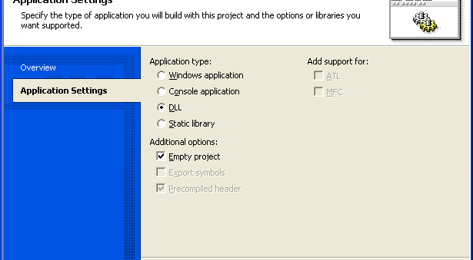
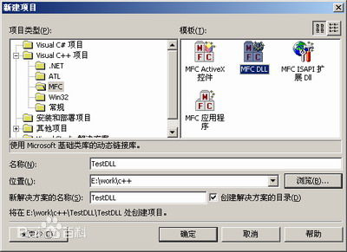
Create MFC_DLL
MFC(Microsoft Foundation Classes) is a class library provided by Microsoft

Slide 12
Program Library(程序库)
A program library is a collection of library programs developed(开发). Library programs are not complete computer programs, they are code that provides services to other programs
Library, Program Library and Library routine, they all mean the same concept.

Slide 13
Program library
Pre-compiled(Code that can be run directly)
Collection of routines
Each routine performs a specific task
Each routine can be linked or imported into the program

Slide 14
More example
For computer games a developer might not have the time and budget预算 to write a new graphics engine so they often buy graphical libraries to speed up development, this will allow them to quickly develop a good looking game that runs on the desired hardware.

Slide 15
Library routines benefits
Less code needs to be written so that it saves time
Pre-tested by many people. It can be sure that the function will perform as it should
Simplifies the program because only the name of the function included in the source code

Slide 16
Library routines drawback
Compatibility/kəmˌpætəˈbɪləti/兼容性 issues.
There may be unknown or unexpected bugs or virus.
Library routine may not meet exact needs
There may be unexpected results .

Slide 17
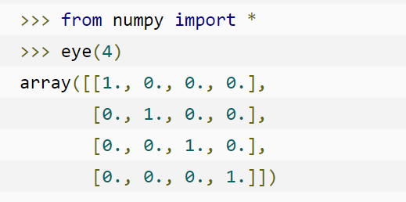
Below is an example of how you might import libraries in python:

